Slide 1




Name of Project:
Interview Preparation Chatbot Using NLP
Name:
Shiva Kumar Radharapu
AICTE Internship ID:
INTERNSHIP_173070615967287aef12823

Slide 2

Learning Objectives:
1.Understanding of Chatbot Design and Functionality:
-Learn the process of designing an intent-based chatbot.
2.Natural Language Processing (NLP) Techniques:
-Understand the usage of TF-IDF Vectorization for text feature extraction.
-Learn how to apply machine learning models like Logistic Regression to
classify interview questions and provide appropriate responses.
3.Building a Streamlit Web Application:
-Learn how to create a web-based interface using Streamlit.
-Develop the skills needed to build interactive applications with a clean,
easy-to-use frontend.
4. Exploring Deployment for Real-World Use:
-Explore how to deploy a machine learning-driven application like this chatbot for real-world use, potentially in job preparation, recruitment agencies, or as part of an online educational platform.
GOAL

Slide 3
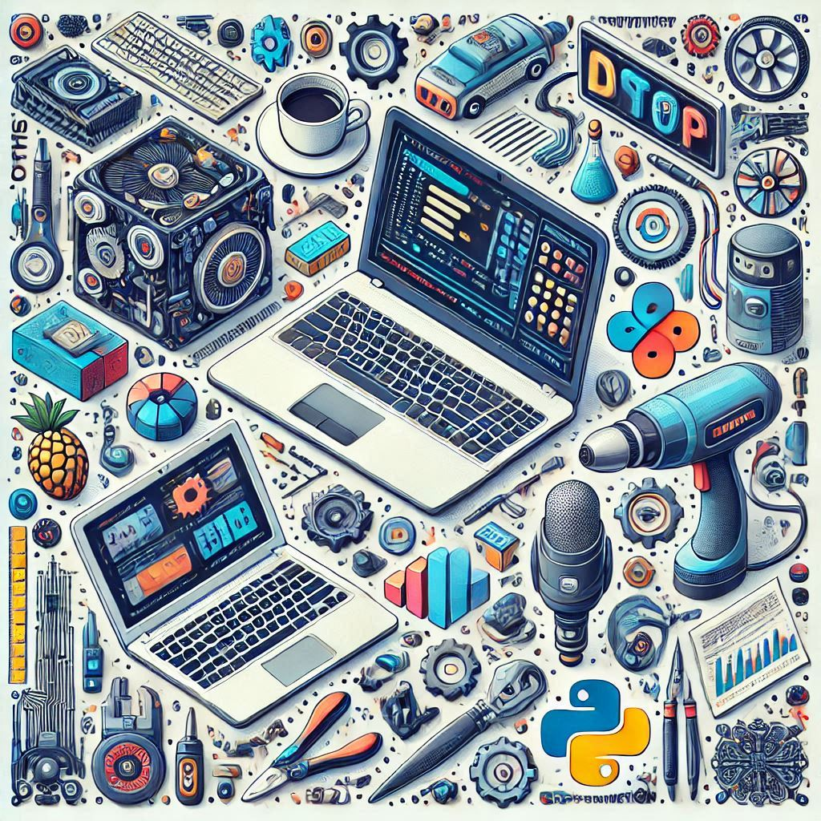
Tools and Technology used
Programming Language:
Python
Machine Learning:
Logistic Regression
Scikit-learn
TF-IDF Vectorizaton
Natural Language Processing (NLP)
TF-IDF (Term Frequency-Inverse Document Frequency)
Web Application Framework:
Streamlit(Python Library)
Development Environment:
VS Code

Slide 4

Methodology
Define Roles and Questions
Curate a database of role-specific questions and answers.
Model Training
Use TF-IDF Vectorizer to transform questions into feature vectors.
Train Logistic Regression models for predicting responses.
Build Chatbot Interface
Develop a user-friendly interface using Streamlit for
question-answer interaction.
Deploy and Test
Integrate trained models into the chatbot application.
Test with various user queries to ensure accuracy.

Slide 5
Problem Statement:
Job seekers face challenges in preparing for interviews, particularly in anticipating questions and formulating effective answers.
Many candidates lack personalized, real-time feedback, leading to
anxiety and underperformance.
Traditional methods of interview preparation are time-consuming and may not simulate the real interview experience.
Objective: To develop a job interview preparation chatbot using Natural Language Processing (NLP) in Python that provides personalized mock interview sessions, offers real-time feedback, and helps users improve their interview performance by practicing commonly asked questions and receiving tailored tips.

Slide 6
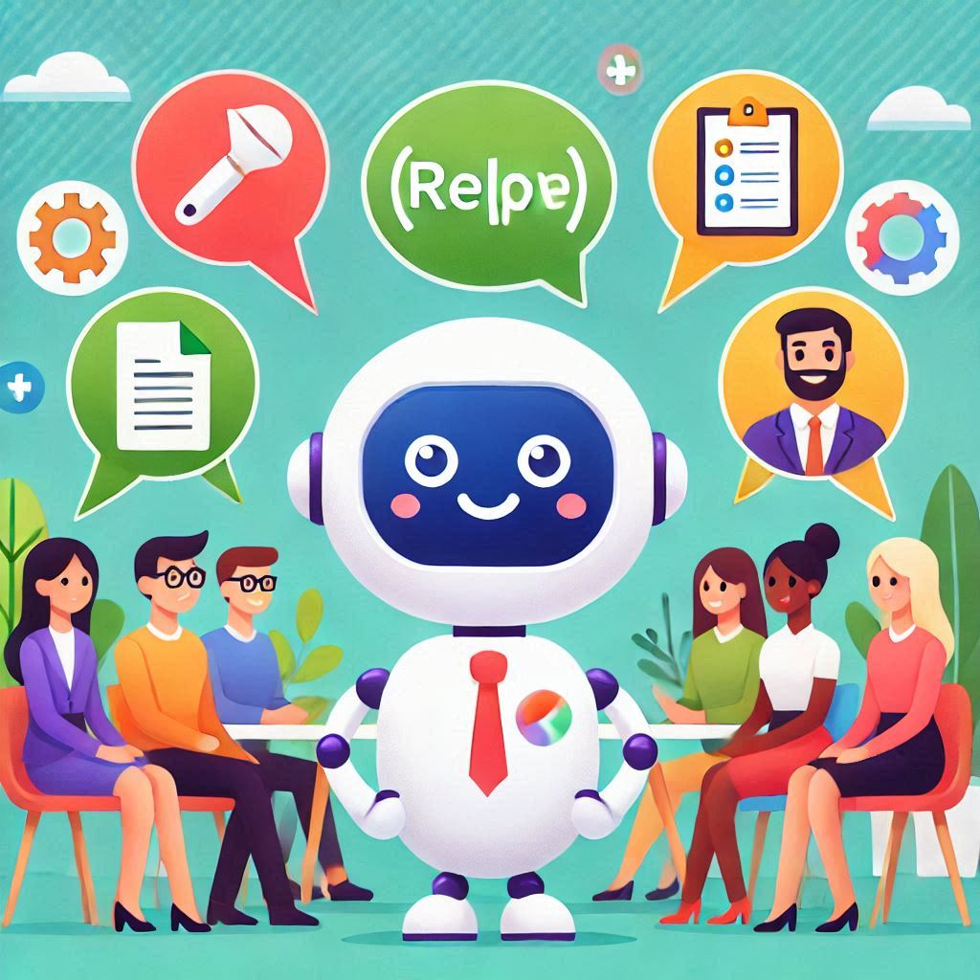
Solution:
Develop a job interview preparation chatbot using Python
and NLP to simulate real interview scenarios.
Provide personalized mock interviews with commonly asked questions
tailored to the user's profile.
Help users build confidence and perform better in actual job interviews.
Design the chatbot to be interactive, user-friendly, and capable of handling
a wide range of interview topics.

Slide 7
Conclusion:
The job interview preparation chatbot leverages NLP to provide personalized, interactive interview practice for users.
By offering real-time feedback and simulating actual interview conditions, the chatbot helps users gain confidence and improve their interview performance.
This solution enhances the job preparation process by making it more accessible, efficient, and user-friendly.
Future improvements could include expanding the question database, integrating more advanced NLP models, and offering multi-language support to cater to a global audience.
This project aims to develop an interactive job interview preparation chatbot using Python and NLP, providing users with personalized mock interviews and real-time feedback. By simulating real interview scenarios, it helps candidates improve their answers and build confidence. The chatbot enhances the job preparation experience, making it more accessible and effective for users.

Slide 8
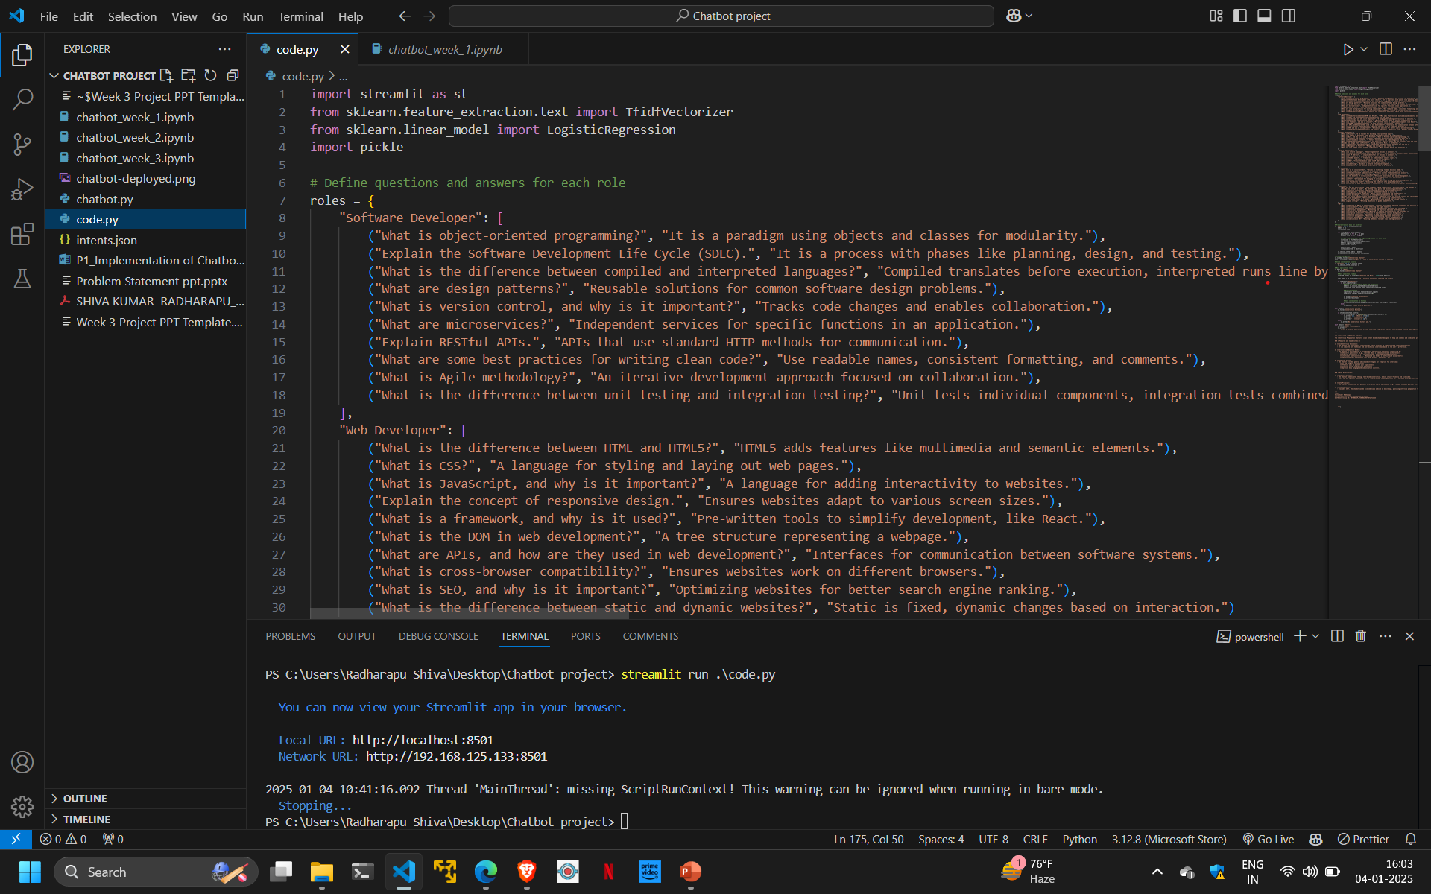
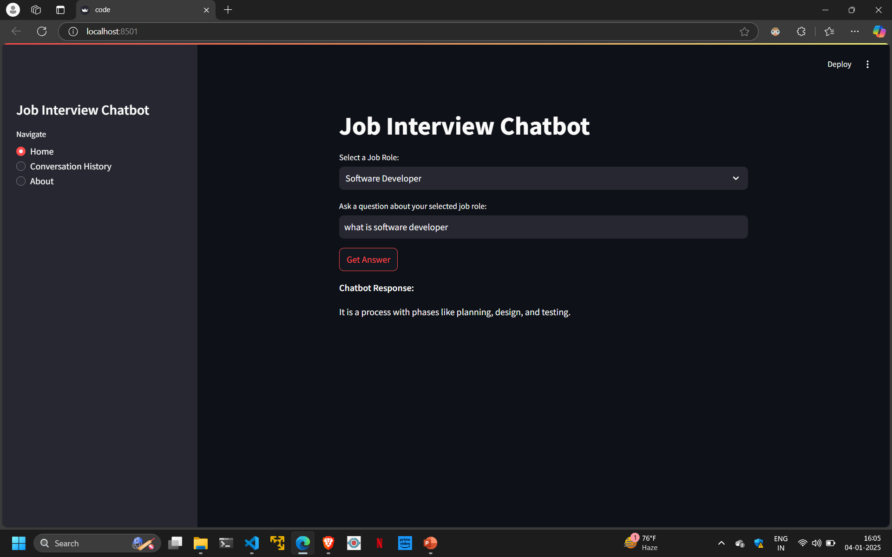
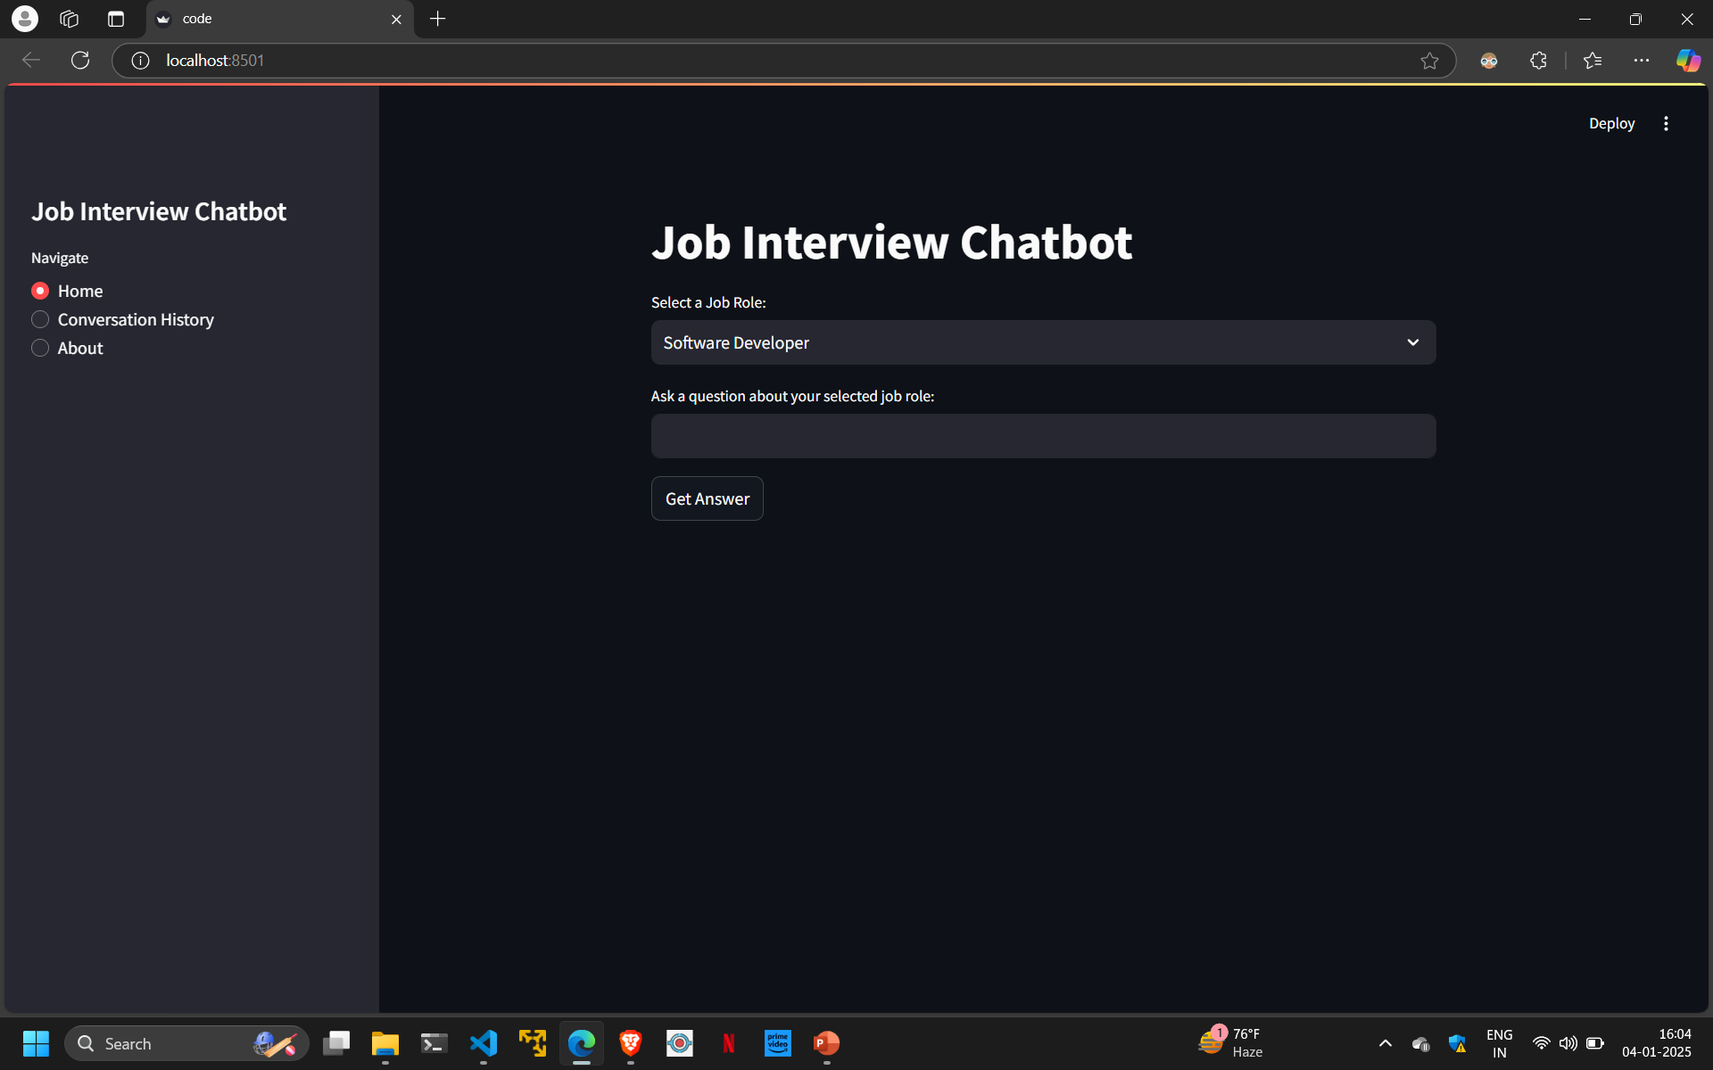
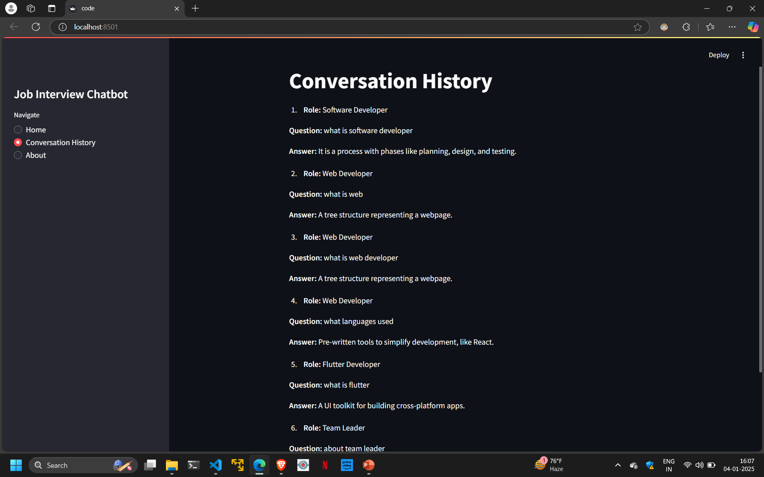
Project output Screenshots:
Fig 1:Source Code
Fig 3:Output Screen 2
Fig 2:Output Interface
Fig 4:Conversation History Screen

